Slide 1
Megatest Debugging Basics

Slide 2
About this tutorial and about Megatest
Target audience: folks running Megatest based automation or QA
  Should have basic knowledge of dashboard, runs, tests etc.
About Megatest
General automation engine somewhat similar in spirit to “make”
Graphical user interface to make running and debugging automated tests easy.

Slide 3
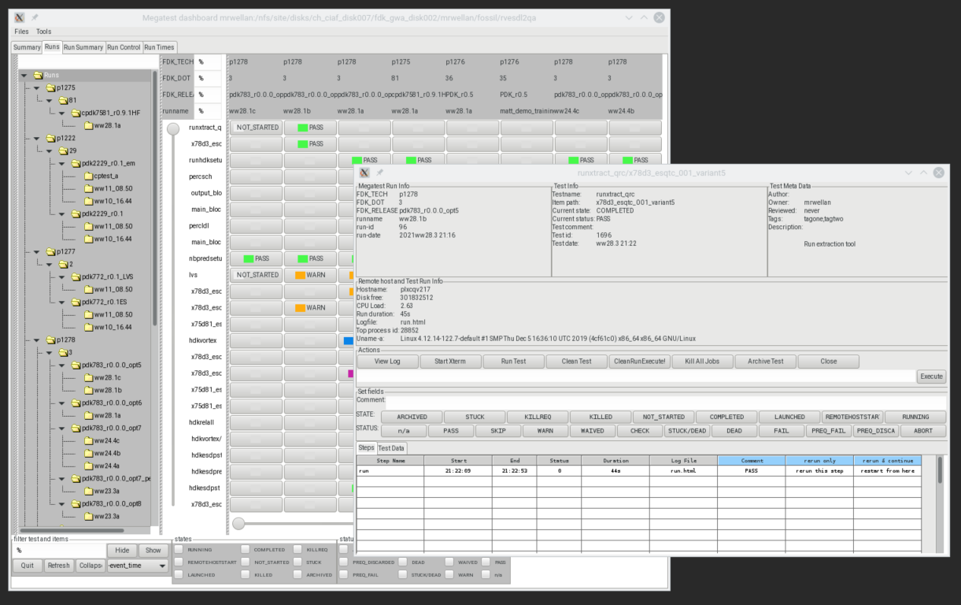
Megatest Dashboard and Test Control Panel
Runs browser tree
Dashboard
Run
Test
Test Control Panel
Test Controls
Steps
Test/items filter
State status filter

